Slide 1
GOAT GAMBLING MACHINE
a BIOLogically Plausible NENGO ACTION SELECTION MODEL

Slide 2
Task
# Two-armed bandit task
# Trial by trial: PAUSE - WATCH - CHOOSE/REWARD
# Agent has to learn the probability of winning of either bandit

Slide 3
Task
# Additional information on one gamble given on every trial
# This information is the amount of money to be won/lost, when gambling
# needs to be incorporated by subject in making the decision within trial

Slide 4
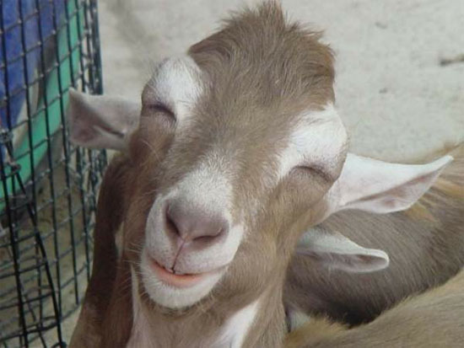
Task
# currency used in the task are goats
# to increase both task motivation
# without too much detachment from reality

Slide 5
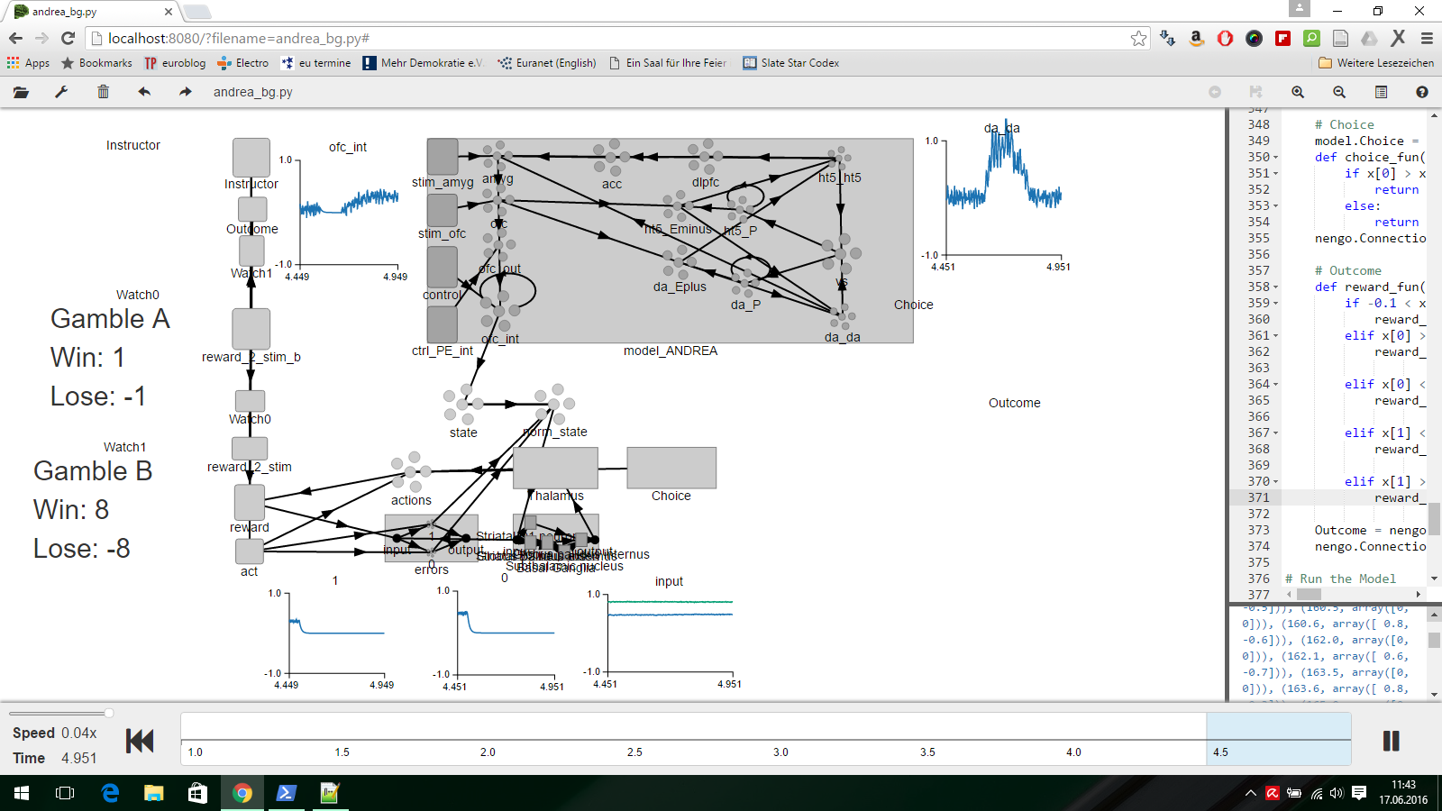

Slide 6
